Slide 1
Billy Elliot and the hate you give
Name
University affiliation
Date

Slide 2

Human experiences
In Billy Elliot, Bill is faced with a distressing experience due to the loss of her mother while in the hate you give, Starr experiences uneasy balance between her two different worlds and these worlds are completely shattered when she witnesses her best friend being shot at by a police officer.
Notes:
In the Billy Ellliot, Bill is faced with a distressing experience when his mother died when he was still a teenager. The loss of the mother was deeply felt by all members of the family. They now had to struggle to deal with the fact that they had to cope with life without her.
In the hate you give, Starr founds herself switching between two different worlds, the worlds that is dominated by the blacks where she resides and the wealthy class, who are mostly whites in the prep school she goes to. She experiences uneasy balance between her two different worlds and these worlds are completely shattered when she witnesses her best friend being shot at by a police officer.

Slide 3
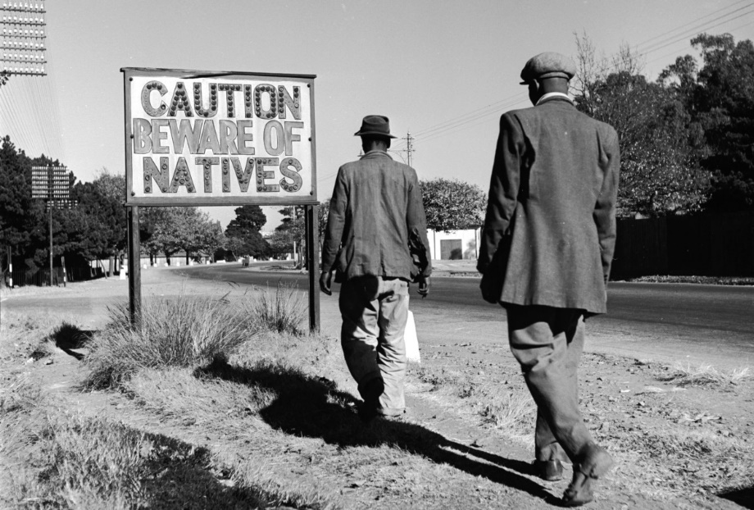
Rampant discrimination
Billy’s father Being a person of color and one of the miners, he faces a lot of insecurity at the workplace as the government dismantles the workers’ union.
Starr experiences and manages discrimination and brutal treatment on the basis of her race. Many places of work are plagued with lack of opportunities and a lot of discrimination for the black people.
Notes:
Billy’s father Being a person of color and one of the miners, he faces a lot of insecurity at the workplace as the government dismantles the workers’ union.
Starr experiences and manages discrimination and brutal treatment on the basis of her race. Many places of work are plagued with lack of opportunities and a lot of discrimination for the black people.

Slide 4
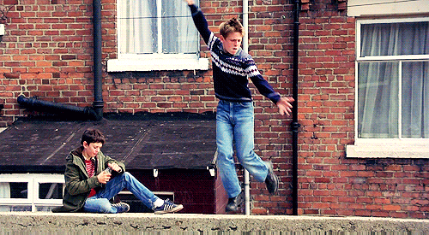
Finding solace
For Billy, he uses ballet that calms him down as he deals with the emotional impact caused by his late mum. Ballet also acts as a means that helps him transit from background of working-class that restricts and defines him.
Starr supresses all the bad memories that irritate her and instead spends much of her time in becoming a resourceful and kind person to everyone around her.
Notes:
For Billy, he uses ballet that calms him down as he deals with the emotional impact caused by his late mum. Ballet also acts as a means that helps him transit from background of working-class that restricts and defines him.
Starr supresses all the bad memories that irritate her and instead spends much of her time in becoming a resourceful and kind person to everyone around her.

Slide 5

Self discovery
Both films illustrate the significance of self-discovery. Many people are not able to achieve their objectives and happiness in life simply because they tend to conform to the society’s requirements. The only way one can find happiness is by accepting one’s differences and remaining committed to meeting one’s objectives
Notes:
Many people are not able to achieve their objectives and happiness in life simply because they tend to conform to the society’s requirements. The only way one can find happiness is by accepting one’s differences and remaining committed to meeting one’s objectives

Slide 6
The new world
Progression of Billy and Starr into the “new world” brings with it opportunities brings about peace of mind as well as growth and development. The change in one’s life can be illustrated through experiences that make a move out of the comfort zone.
Notes:
Billy was able to challenge his parent’s expectations that provided him with a unique room for growth and development while Starr finally found her inner peace and voice that helped her stand up for what she thought was just and right.

